Slide 1





PARKINSONS DISEASE PREDICTION USING MACHINE LEARNING
Group ID: PCSE25-70
Team Leader : Varun gupta
Group Member: Varun gupta
Group Member: Sumit pal
Group Member: Yash jain
Semester : 8
Semester : 8
Semester : 8
Department: CSE Department: CSE Department: CSE
Name of Guide : Swati Sharma
Date of Presentation : 24/05/2025

Slide 2
Introduction
Parkinson’s disease is a movement disorder that affects the central nervous system. The symptoms start gradually because of low dopamine levels in the brain. Dopamine is a chemical and is a neurotransmitter responsible for sending signals from the body to the brain. Reduction in the neurons responsible for production of dopamine leads to lowering of dopamine levels resulting in reduced coordination between the brain and the body. Till date there's not any cure for this disease and with the advancement of technology, it is necessary to introduce a quick and reasonable tool to predict the disease.

Slide 3
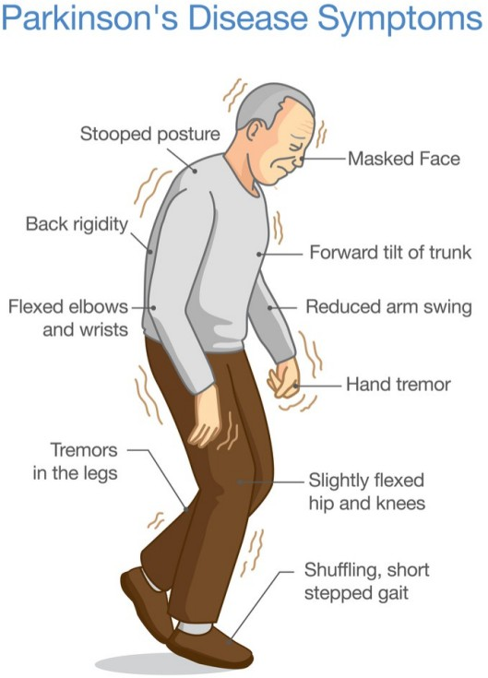

Slide 4
Symptoms associated with PD depending on stage Machine learning can be used as a powerful tool for the prediction of various kinds of disease. It can help to predict the presence of PD more accurately and cost effectively. One of the main symptoms of PD is loss of speech. The resultant problems may include monotonic speech, slur words, mumbling, breathy or hoarse speech etc.
Keeping the points in mind, we decided to go with a voice dataset containing 25 features. In order to select the best features, Pearson method of correlation is used.
In this project, we present a prediction system for PD using the XGBoost model and the Pearson method of correlation for feature selection to predict the presence of Parkinson‟s Disease.
The algorithms used in the analysis for choosing the optimistic algorithms are:
SVM
Random Forest
XGBoost

Slide 5
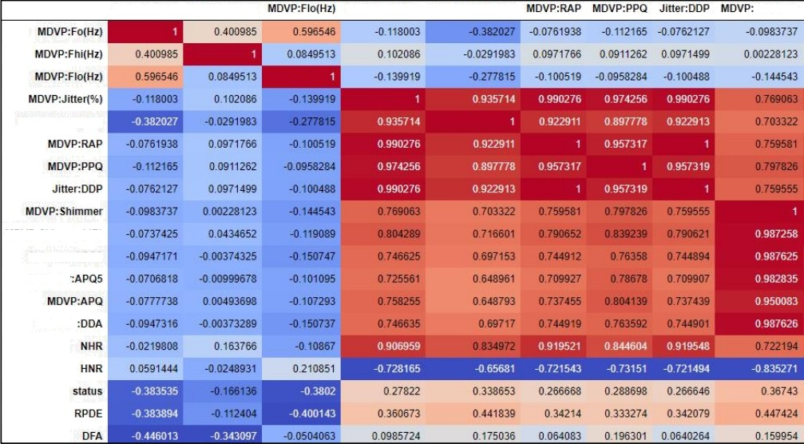
MDVP:Fo(Hf)
MDVP: - hi(Hz)
MDVP:Jitter(‘ x)
MDVP:J ilter(Abs\
Shiinnier
MDVP:J irter{Abs)
MDVP: Shimmer(dB)
Sh iinmer’APQ3 Sh in›mei
Shiin t er

Slide 6

Why We need it?
Parkinson's Disease is a chronic and progressive neurodegenerative disorder that affects millions of people worldwide. Early detection of Parkinson's Disease is crucial for effective treatment and management of the disease, as early intervention can help slow the progression of symptoms and improve quality of life for patients. However, current methods for Parkinson's Disease diagnosis are often subjective and rely on clinical observation, which can lead to misdiagnosis and delayed treatment.
Machine learning has the potential to significantly improve the accuracy and efficiency of Parkinson's Disease diagnosis. By training a machine learning model on a dataset of voice recordings from individuals with and without Parkinson's Disease, the model can learn to recognize patterns in the data that are indicative of the disease. This can lead to more objective and accurate diagnosis of Parkinson's Disease, which can ultimately improve patient outcomes. Overall, the development of a machine learning model for the detection of Parkinson's Disease is needed to improve the accuracy and efficiency of diagnosis, and to provide patients with earlier intervention and better treatment options.

Slide 7




Project objective
Our 4 Major Objectives of our project are:-
To develop a machine learning model for the detection of Parkinson's Disease based on voice features.
To train the machine learning model on a dataset of voice recordings from individuals with and without Parkinson's Disease.
To evaluate the performance of the machine learning model using metrics such as accuracy, precision, recall, and F1 score.
To compare the performance of the machine learning model to existing methods for Parkinson's Disease diagnosis.
To identify the most important voice features for Parkinson's Disease detection using feature selection techniques.
To develop a user-friendly application for the deployment of the machine learning model.

Slide 8
Facilities required for proposed work
The facilities required for the development of this project include both software and hardware.
The software required for this project includes Python programming language, machine learning libraries such as scikit-learn, TensorFlow, and Keras, and database management systems such as MySQL. Additionally, software for developing the user-friendly application, such as HTML, CSS, and JavaScript, will be required.
The hardware required for this project includes a computer with sufficient processing power and memory to handle the data preprocessing and machine learning algorithms. A microphone or other audio recording device will also be required to collect voice recordings for training and testing the machine learning model.
Overall, the facilities required for this project are readily available and accessible, and can be easily obtained and installed. The software and hardware requirements are standard for machine learning and software development projects, and can be easily met by most modern computers and devices.

Slide 9



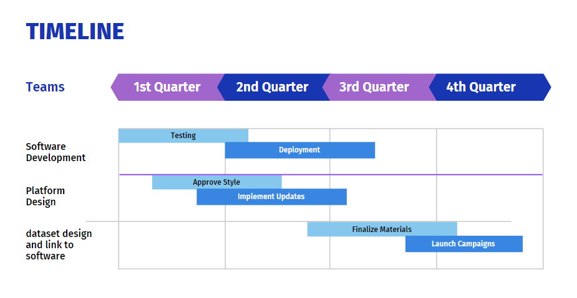


Timeline

Slide 10
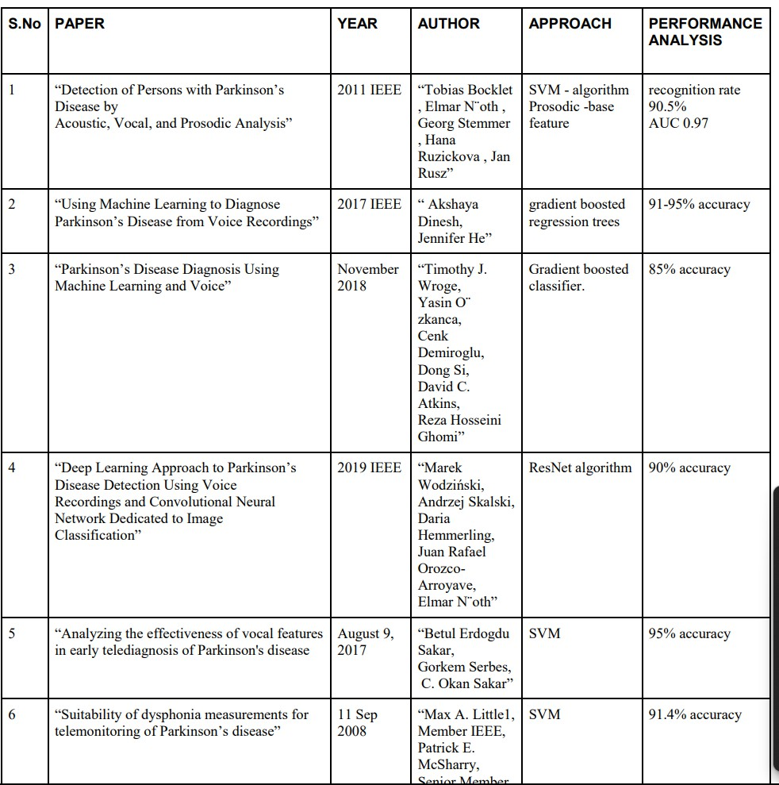


LITERATURE REVIEW

Slide 11
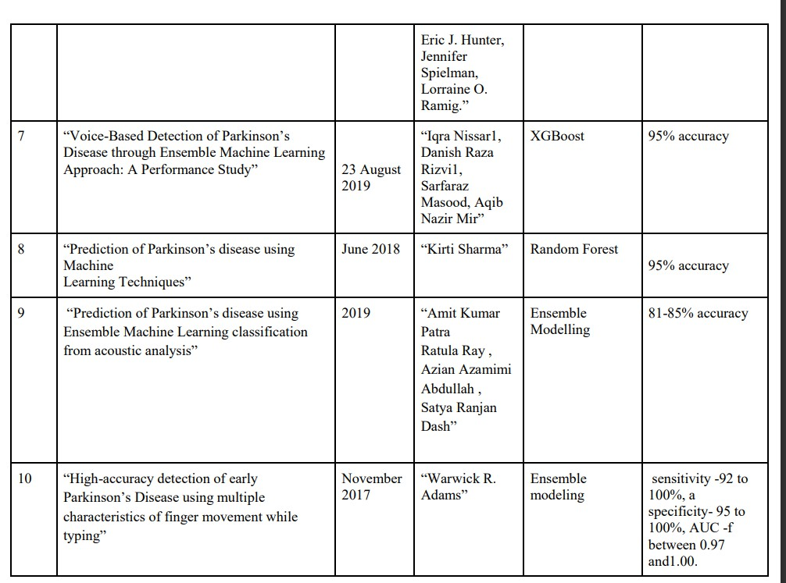

Slide 12





THANK YOU

